Slide 1
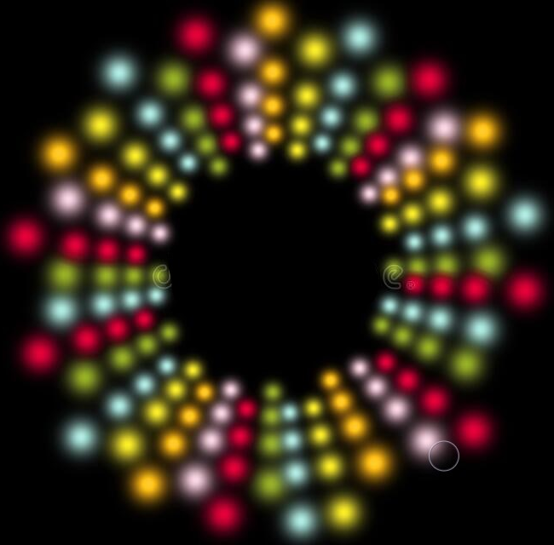
Light Painter
by AirBuds
Ryan Nasers, Dylan Sitarski, John Ackert, Cade Shramek, Dillon Romans

Slide 2

Problem Statement
Can we create a game that is simple enough for the Circuit Playground Express but still satisfies the principles of good game design?
Players must feel a sense of
curiosity and freedom
lasting impact
progress
reward
The game must
allow for competition
allow for mastery and replayability
Objective: maximize fun and retain attention!

Slide 3
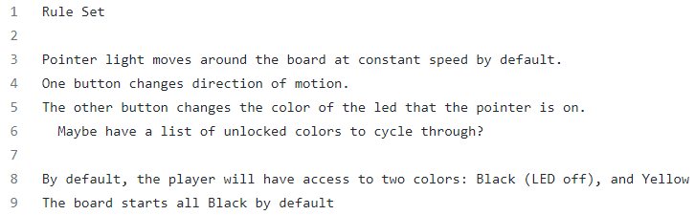
Strategy
That is a lot to ask from 10 LEDs and 2 buttons!
We took it in steps - incorporating one principle at a time.
Curiosity/freedom motion and interaction controls
Lasting impact control over LED colors
Reward color unlocking mechanic
Progress colors have special properties to discover
Competition track time until all colors unlocked
Mastery/replayability add difficulty settings
A rule set was made to work out the specifics and prepare for coding.
Gameplay is being tested as the game is developed.

Slide 4
How It Works
Controls:
A white “cursor” constantly orbits the board
One button changes the direction of orbit
The other button changes the base color of the LED that the cursor is on
Gameplay:
By default, all LEDs are off and the player can toggle between off and yellow
The second color, green, is unlocked when 3 LEDs in a row are yellow
The rest of the colors are unlocked under other unique conditions
Each color has a special property - e.g. the cursor moves slower over green
The game is won when all colors are unlocked!
Difficulty levels change movement speed and amplify color properties

Slide 5




Status On Track!
Proposal
Rule set
Final Presentation (almost!)
Main code
Hardware
Gameplay testing
Final Report

Slide 6
Potential Problems and Possible Solutions
Trouble discerning colors that are too similar (i.e. yellow and orange)
Change choice of colors or experiment with different shades
Input delays or unresponsive controls
Decrease cursor speed
Generally boring gameplay
Add more challenging elements such as losing scenarios
JSON file confusion for the user
Make sure that the game comes with clear documentation on how to change the JSON file the way the user requests.

Slide 7

Demonstration

